Slide 1
Object Oriented Programming Principles
Learn & implement with UML in C++, Java &C#

Slide 2
Instructor
Umar Lone
B.E. Civil
Languages – Assembly, C, C++, Java, C#, Objective C, Javascript
Frameworks : MFC, ATL, Boost, ACE
Platforms : Win32, Android, iOS, Linux
Other: OO Programming, Design Patterns, Unity3D
Poash Technologies (www.poash.com)

Slide 3
Who is this course for
Anyone who wants to understand and implement object oriented programming principles
College grads or software developers
Software developers working in any language
Software designers/architects

Slide 4
Prerequisites
Basic programming knowledge
C# & C++ - Visual Studio 2017/2019 Community Edition
Java - Eclipse

Slide 5
Course Objectives
Learn how to analyse a system using object oriented analysis
Learn how to design systems using object oriented design
Understand OO programming principles
Understand how OO programming helps write large, scalable systems
Learn how to use common UML diagrams for analysis & design
Implement OO programming principles in C++, C# & Java

Slide 6
Object Oriented Programming Principles

Slide 7
Purpose of software
What is the purpose of software?
perform complex tasks/calculations
ease complexity
reduce human intervention
reduce errors
perform monotonous work
....
Is developing software complex?

Slide 8


Software Complexity
Many objects in this world exhibit great complexity
heart beating, photosynthesis, weather, etc
Applies to software as well
database systems
financial systems
air traffic controller
The complexity is too great for one person to understand
Complexity can never be eliminated; but it can be reduced

Slide 9
Reasons for software complexity
Problem domain complexity
some domains are complex e.g. finance, telecom, etc
lends itself to software
non-functional requirements, such as usability, performance, cost, etc. add to the overall complexity

Slide 10
Reasons for software complexity
Communication between users and developers
may have vague idea of what they expect from the software
difficult for users to express their requirements
developers expect requirements in a specific format (e.g. UML)
both users and developers may lack domain experience
users get a better idea of the system only after seeing prototypes or design documents
may request a change that is difficult to incorporate

Slide 11
Reasons for software complexity
Volatile nature of requirements
requirements change
may be difficult, if not impossible to incorporate that change
future changes must be anticipated

Slide 12
Reasons for software complexity
Unpredictable behaviour of software
software runs on systems with discrete components
application may have multiple threads, variables, memory allocations
large number of events and states
causes combinatorial explosion
interaction between components

Slide 13
Reasons for software complexity
Developmental process
big teams
geographical locations
communication/coordination between developers
resource shortage

Slide 14
Summary
Software solves problems & reduces complexity
Writing software is complex!
Factors such as domain, requirements, etc., contribute to the complexity of the software

Slide 15
Complex Objects
Name 5 objects in this world that exhibit great complexity

Slide 16
Resolving Complexity
Human beings have a built-in mechanism for dealing with complexity
Decompose each part into smaller parts till each part makes sense individually
Finally, integrate the parts to build the final system
“divide et impera” – divide and rule
Same principle is applied to programming languages
Notes:
deal with complexity by breaking it down

Slide 17
Algorithmic Decomposition
Decomposes the problem into algorithms
Each algorithm is part of a series of steps (part of overall process)
Typically, a top-down approach
start with a big picture
break down into smaller chunks
These steps lead to the final result (like a flow chart)

Slide 18
Example
Write a software to help tutors prepare report card for their students
The software will
Accept student details (name, class, rollno)
Accept test details (semester/unit)
Accept subject name and score
Calculate total score
Calculate average score
Assign grade
Display lowest & highest scoring subjects(based on some threshold

Slide 19
Decompose
InputStudentInfo
InputTestInfo
InputSubjectInfo
Calculate
AssignGrade
DisplayDetails
Accept
Calculate
Display
Prepare Report Card
Decompose
Decompose

Slide 20
Execution
Prepare Report Card
Input
Calculate
Display
StudentInfo
AssignGrade
SubjectInfo
TestInfo

Slide 21
Disadvantages
Development based on the high-level specification
Often changes over time
parts have to be rewritten
Algorithms are very specific to the application, thus, difficult to reuse
Difficult to add new features
algorithms are tightly wired to work together
Data is treated with low significance
data is shared between algorithms
unintentional modification can lead to disastrous results
Focus on operations
no idea about the entity on which operation is performed
overall understanding of the application becomes complicated
doesn’t map to real life entities

Slide 22
Algorithmic Decomposition
ALGORITHM A
ALGORITHM B
ALGORITHM C
DATA

Slide 23
Languages
Languages based on algorithmic decomposition
Fortran
Cobol
Pascal
C
...

Slide 24
Summary
Algorithmic decomposition
Focus on operations rather data
Doesn’t scale well
Doesn’t map to real world

Slide 25

Object Oriented Decomposition
Humans can also abstract complexity and focus only on necessary details
unwanted details are ignored
deal with relevant details only
leads to simple entities in the problem domain
OS
Storage
Battery
Networks
Screen size
Camera
Filesystem type
Battery type
Camera aperture
Image format
Color space
Notes:
Interview example

Slide 26
Object Oriented Decomposition
Recognize relationship between these entities
some entities may be generalized
Understand how they interact and coordinate
The coordination gives rise to the functionality of the system
Notes:
Interview example

Slide 27
Object Oriented Decomposition
Uses bottom-up design
The system is decomposed as a set of autonomous, but cooperative agents
These agents are objects and represent key abstractions in the problem domain
designed with detail
Each object has its own behaviour
Models some object in the real world
The objects coordinate with each other
coordination gives rise to functionality of the system
send messages to each other

Slide 28
Object Oriented Decomposition
Messages
Object A
Object E
Behaviour & Data
Object B
Object X
Object D
Object C

Slide 29
Object Oriented Decomposition
ReportCard
Generate
GetDetails
Subjects
GetMarks
Student
ComputeAverage
Test
GetGrade

Slide 30
Advantages
Follows separation of concerns
each entity has its own responsibility
addresses the complexity through organization
System is made of objects that represent real-life entities
Maps closely to real-world problems
Data has high importance
part of the object, not visible externally
Enables generalization of objects
promotes reuse of common functionality
leads to smaller systems
Evolve incrementally over a period of time

Slide 31
Summary
OO decomposition views the system as a set of autonomous objects
Objects collaborate with each other
Data has prime importance and is hidden
Maps closely to real-world problem domain

Slide 32
Evolution
Early computer languages were created for scientific and mathematical operations
To accommodate complexity and large systems, new languages were invented
Procedural languages were used for a long time, until complexity of systems further increased
required reuse, scalability
Eventually, OO languages like Simula, Smalltalk, C++, Java, etc came into picture
The building block in these languages are classes & objects rather than algorithms

Slide 33
Object Definition
An object represents an individual, identifiable item, unit or entity, either real or abstract, with a well defined role in the problem domain *
-Smith and Tockey
Model some part of reality
Exists in space and time
Can be invented as outcome of a design process
Has well-defined behaviour and a definite purpose
Collaborate with other objects to provide a higher-level behaviour
* Smith, M., and Tockey, S. 1988. An Integrated Approach to Software Requirements Definition Using Objects:Boeing Commercial Airplane Support Division

Slide 34
Characteristics
An object has the following characteristics:
state
identity
behaviour
The structure and behaviour of similar objects are specified in a class
object is an instance of such class
a class is the blueprint for objects
Forms the building block of an application

Slide 35
State
Properties and their values constitute the state of an object
Appear as attributes of an object
fields, member variables, etc
Can be of two types
static – fundamental attributes that don’t change
dynamic – attributes that change as a result of operation performed on the object

Slide 36
Example – Speaker System
Static
Dynamic
Power
No. of speakers (2, 2.1, 4.1, etc)
Connectivity
Color
Brand
Serial no.
Volume
Treble
Bass

Slide 37
Example – Cellphone
Static
Dynamic
CPU
Storage size
Display size
Supported bands
OS
IMEI number
State (standby, in-call)
Remaining storage
Battery level
Signal strength

Slide 38
Identity
Trait that makes an object unique and gives it individuality
Represented through one or more attributes of the object
address of an object can be used to represent its identity in some cases
Helps identify objects in a system
Examples
Speak System – Serial no.
Cellphone – IMEI no.
Person – Social security no.

Slide 39
Behaviour
Response of the object during interaction
Part of the responsibility of an object
Arises due to binding between attributes and operations
operations will internally change the state of the object
this culminates into the behaviour of the object
Appear as operations (member functions, methods)
Examples
speaker system – ChangeVolume, ChangeBass, ChangeTreble, EqualizeLoudness
cellphone – SendText, Dial, AcceptCall, Connect

Slide 40
Examples
Bank account
Credit Card
File on a hard drive
Employee

Slide 41
Object Model

Slide 42
Evolution Of Languages
Early computer languages were used for mathematical & scientific operations
freed the programmer from the intricacies of assembly language
Growth in size & complexity led to evolution in languages to accommodate new features
e.g. automation for business applications
Slowly, the languages evolved even more
software moved closer to problem domain and further away from machine

Slide 43
Object Model
The newer languages used classes & objects instead of subprograms & algorithms as building blocks
These languages build upon object model
The object model is based on three important concepts
object oriented analysis
object oriented design
object oriented programming

Slide 44
Object Oriented Analysis
OO analysis is a method of analysis that examines the requirements from the perspective of the classes & objects found in the vocabulary of the problem domain
Grady Booch
This is the first step for developing an object-oriented system
Investigation of problem and requirements rather solution
Focuses on what the system is supposed to do rather how it will be done
Looks at the behaviour of the system independent of its domain
Examines the real-world environment in which the system will operate
includes people and things that will interact to produce some result
analysed in a basic abstract forms, in multiple iterations
these abstractions later become classes in the problem domain
Object Oriented Analysis & Design with Applications 3rd Edition – Grady Booch & others, Pearson

Slide 45
OO Analysis Library
Member requests a book from the library
Librarian will search for the book
If found, the book is issued
The database is updated with the issued book
If unavailable, the request is placed in a queue
If not found, an order may be placed for the book

Slide 46
Analysis
Highest level analysis or abstraction
This will continue until objects are uniquely identified
The objects are refined as abstractions with key characteristics
Emphasis on investigation rather than the solution

Slide 47
Object Oriented Design
OO design is a method of design encompassing the process of OO decomposition and a notation for depicting both logical and physical as well as static and dynamic models of the system under design
Grady Booch
Focus on object oriented decomposition
Uses different notations to express different models of the system
High level concepts of analysis are mapped onto classes
Hierarchical associations among the classes are designed
Results in a detailed description that specifies how the system is to be built using different technologies
Object Oriented Analysis & Design with Applications 3rd Edition – Grady Booch & others, Pearson

Slide 48
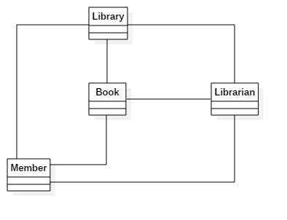
OO Design Library

Slide 49
Object Oriented Programming
It is a method of implementation in which programs are organized as cooperative collections of objects, each of which represents an instance of some class, and whose classes are all members of a hierarchy of classes united via inheritance relationships
Grady Booch
Uses objects as fundamental blocks
Classes & objects are related through relationships
Requires a programming language that supports
objects as abstractions
classes
generalization of classes
Java, C++, C#, etc., can be used to write object oriented programs
Object Oriented Analysis & Design with Applications 3rd Edition – Grady Booch & others, Pearson

Slide 50
Summary
Object model builds upon three important concepts
OO analysis, design & programming
Analysis focuses on problem
Design is about OO decomposition and expression of the design using some notations
Programming is the implementation using an OO language

Slide 51
Why Model Software Systems
Software development is complex
Modelling can help build a system easily & quickly
Useful in simulations
Can evolve when our understand of the system increases
We can choose the details in the model
Simple view of the system
No need to dig into the system for details
A model can represent real or abstract things in any domain

Slide 52
Model
A model is an abstraction of something that exists in real life
“A model captures the view of a physical system. It is an abstraction of the physical system, with a certain purpose. This purpose determines what is to be included in the model and what is irrelevant. Thus, the model completely describes those aspects of the physical system that are relevant to the purpose of the model, at an appropriate level of detail.”
OMG UML Version 2.5

Slide 53
Modelling Language
Made up of pseudo-code, pictures, comments, diagrams, etc
These elements make up a modelling language
called notations
Code may be used for modelling
too verbose i.e. information overload
only models implementation, not design
cannot be easily ported to other implementations
does not give a bigger picture of the system
clients may not understand code

Slide 54
Modeling in Informal Languages
Informal languages don’t have formal notations
For example, we may use natural language, but
difficult to express
leads to ambiguity
no rules
not suited for systems modelling
non-standard notations

Slide 55
What is UML
UML is the “Unified Modelling Language”
Standard modelling language for software development
Maintained by Object Management Group
Current version is 2.5
Brings together ideas of three modelling methods of Jacobson, Rumbaugh & Booch
Made up of pseudo-code, actual code, pictures, diagrams, etc
Describes the system we want to develop
Depends mostly on notations to describe the system

Slide 56
What UML Is Not
It is not a modelling tool
It is just a way to model system
It is not a programming language
It is not a methodology or a process
Rather it helps document various stages of a process

Slide 57
Why UML
Systems design on large scale is difficult
All kinds of applications will have thousands of components that interact with each other
components need to be tracked
usefulness of a component for a system has to be ascertained
customer requirements have to be considered
Designs need to be shared with stakeholders
UML helps model this kind of complexity
captures, documents and helps communicate important aspects of the system’s design

Slide 58
UML Advantages
Formal
Concise
Comprehensive
Scalable
Standard

Slide 59
View Model
Defines a coherent set of views that are used in construction of a software architecture
A view represents the whole system from the perspective of a related set of concerns
This allows different stakeholders to view the system from their viewpoint
The view model is an effective approach for dealing with the inherent complexity of the large distributed systems

Slide 60
Intent
The intent is to use a mechanism that separates the different aspects of the software system into different views
Different stakeholders have different interest in the system
programmers – classes
administrators – hardware, network configuration, etc
customers - usability

Slide 61
View of the Model
UML model diagrams can be broken into different perspectives or view
Can be explained through Kruchten’s 4+1 model
Logical View
Process View
Use Case View
Physical View
Development View

Slide 62
Object Oriented Analysis with UML

Slide 63
Unified Modelling Language (UML)
Standard modelling language for software development
Describes the system we want to develop
Uses notations to describe various aspects of the system
Formal language
Standardized
Used in various software development methodologies

Slide 64
UML Diagrams
Use case
Class
Object
Sequence
State Machine
Component
Package
etc

Slide 65
Object Oriented Analysis
OO analysis focuses on the problem and the requirements
Focus on what the system is supposed to do
Implementation details are mostly ignored
An analysis model is created
done through user stories or use cases
involves key abstractions from the problem domain
constraints of technologies are ignored
Notes:
Examination of the real-world environment
Considers people and objects that are going to collaborate for some output
Uses abstraction to narrow down the focus on important parts of the system
Main goal is to model a system’s functional requirements
Developers work with users and domain experts to define

Slide 66
Steps
Find
Find the key objects
Describe
Describe how they interact
Define
Define the internal behaviour of each object

Slide 67
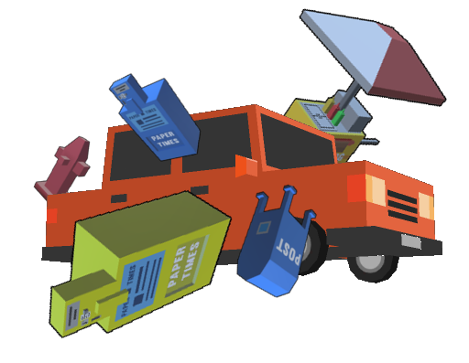
Example : Car Game (Reckless Driver)
Objective : Keep driving as long as you can & earn money by smashing objects. Spend money on powerups.
Smash into traffic, side objects (hydrant, phone booth, etc.)
Each hit will damage the player car and reduce its health
repair through health pickups
Amount of damage caused is accumulated by the player
Smash anything, except trees & police cars (causes instant player death)
Powerups are available
Heavy armour : protects player car from damage
Bomb : destroys objects in the path of the player car

Slide 68
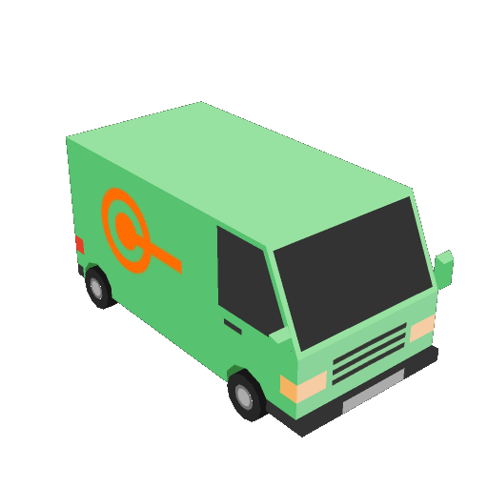
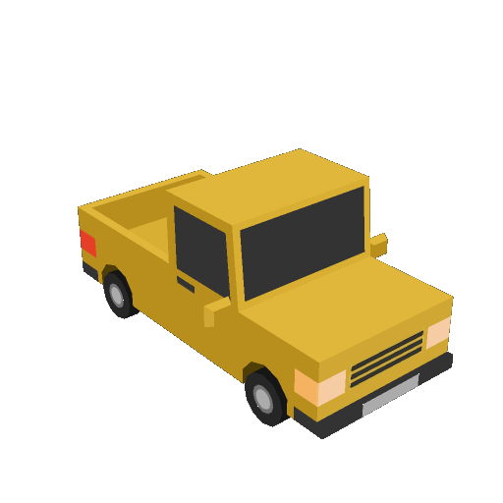
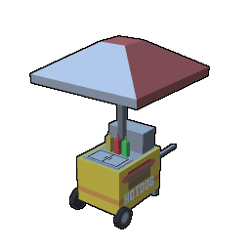
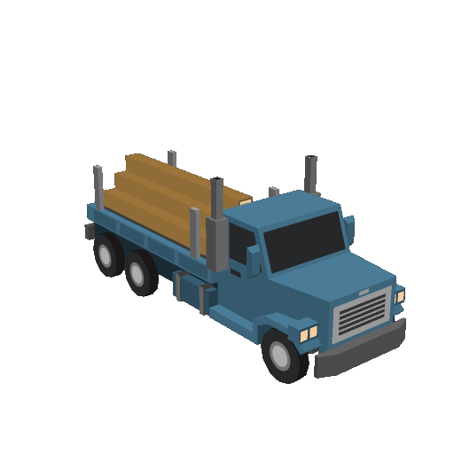
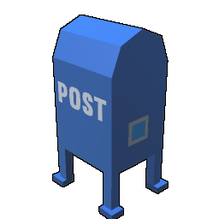
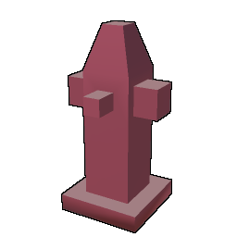
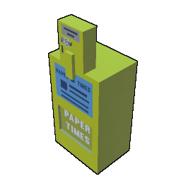

Key Objects
Player Car
Traffic cars
Fire Hydrant
Phone booth
Newspaper box
Bus stand bench
Hotdog cart
Tree
etc

Slide 69
Example Gameplay
The player car smashes into traffic car
Show sparks at point of contact
Play crash audio
Apply damage to player car & reduce health
Compute damage caused to traffic car
Accumulate damage as cash

Slide 70
Use Case
Defines a model of a system behaviour
Uses natural language
designers and programmers use as a common reference
Decomposes large system specification into small, manageable parts
Smaller parts are easily described, hence easily implemented
Models functional behaviour of the system

Slide 71
Use Case Description
Description | Details
Goal | Use case’s place within the system and why it is important
Preconditions | What is required before use case execution
Successful End Condition | System condition after successful execution
Failed End Condition | System condition after failed execution
Primary Actors | Actors that may trigger the use case
Secondary Actors | Actors that participate but are not main players in a use case’s execution
Trigger | Event that causes the use case to execute
Main Flow | Important steps in a use case’s normal execution
Extensions | Alternative steps in use case execution
Notes:
Not hard and fast rule what goes into use case descriptions

Slide 72
Gameplay
Description | Details
Goal | Remain alive as long as you can
Preconditions | Player has enough health
Successful End Condition | Player earns cash
Failed End Condition | Player dies
Primary Actors | Player
Secondary Actors | System
Trigger | Player starts the game

Slide 73
Main Flow
Description | Details
Main Flow | 1. Player starts the game
 | 2. Player smashes into the traffic car
 | 3. Play crash audio
 | 4. Show sparks
 | 5. Apply damage to player car & reduce health
 | 6. Compute damage caused to traffic car
 | 7. Accumulate damage as cash

Slide 74
Alternate Flow
Description | Details
Alternate Flow | 2a. Player smashes into police car
 | 5a. Player health reaches 0

Slide 75
Summary
UML is used for object oriented analysis
It is a formal and standardized language
Uses notations to describe the system
Use case description is used to model system behaviour
Uses natural language

Slide 76
Use Case Diagram

Slide 77
Use Case
Describes a discrete unit of behaviour that has a clearly defined scope
Illustrates what should be done to achieve the goal of the use case
This ultimately maps into program code
Shown as an oval shape with the description of the behaviour
Smash into car

Slide 78
Actor
External entity that interacts with the system
Could be a person, system or some external entity
Maybe defined outside the system
Acts as a black box and cannot be changed
Appears as a stick figure
Player

Slide 79
Communication Line
Connects an actor and a use case
Indicates participation of an actor
Appears as a line between an actor & the use case
Smash into car
Player

Slide 80
System Boundaries
Indicates separation between actors and use cases (internal to the system)
Marked by a bounded box around the use cases
Game
Smash into car
Player

Slide 81
Example
Game Play
Start new game
Smash into car
Player
Notes:
Supports reuse between use cases e.g. while creating a normal user account or a time-based user account, the credentials of the employee have to be checked in both the cases

Slide 82
Modelling Tools
Enterprise Architect
Microsoft Visio
Star UML
Papyrus
Visual Paradigm

Slide 83
Demonstrate creating a use case diagram in Star UML
Available for Windows, Mac & Linux
Compatible with UML 2.x standard
Support major programming languages and generate code for them
Can also reverse engineer and build a model from source
Through extensions

Slide 84
Use Case Relationships
Talk about what happens when side objects are smashed

Slide 85
Side Object Collision
Description | Details
Main Flow | 1. Player starts the game
 | 2. Player smashes into the side object
 | 3. Play crash audio
 | 4. Show side object behaviour
 | 5. Apply damage to player car & reduce health
 | 6. Compute damage caused to the side object
 | 7. Accumulate damage as cash
Description | Details
Main Flow | 1. Player starts the game
 | 2. Player smashes into the traffic car
 | 3. Play crash audio
 | 4. Show sparks
 | 5. Apply damage to player car & reduce health
 | 6. Compute damage caused to traffic car
 | 7. Accumulate damage as cash

Slide 86
Use Case Relationships
Some use cases use similar steps in their behaviour
Others may have different modes or special cases
Depicting such uses cases may cause users to repeat them in the diagrams
This will lead to large and complicated diagrams
UML provides different notations for representing these behaviours

Slide 87
<<include>> Relationship
A use case may reuse all the steps from another use case
it “includes” the steps from another use case
This can be depicted through <<include>> relationship
In diagram, shown as a dashed arrow between use cases with <<include>> label
tail end is towards the use case that reuses the steps
arrow end points towards the use case that is reused
Included use cases are mandatory and not optional

Slide 88
<<include>> Notation
Including use case
<<include>>
Included use case
Notes:
Including use case depends on the included use case. Always includes the behaviour of the other use case

Slide 89
Example : <<include>>
Game Play
Smash into side object
<<include>>
Show object behaviour
Smash into car
<<include>>
GameManager
Player
Notes:
Supports reuse between use cases e.g. while creating a normal user account or a time-based user account, the credentials of the employee have to be checked in both the cases

Slide 90
Example : <<include>>
ATM Transaction
Check balance
<<include>>
Validate pin
Withdraw cash
<<include>>
System
Customer
Notes:
Supports reuse between use cases e.g. while creating a normal user account or a time-based user account, the credentials of the employee have to be checked in both the cases

Slide 91
Generalization
Used to show that one use case is a type of another, but with some changes
Depicted through the generalization arrow
Arrow head points to generalized use case
Tail points to specialized use case

Slide 92
Generalization Notation
Parent use case
Child use case
Child use case
Notes:
Including use case depends on the included use case.

Slide 93
Example: Generalization
Game Play
Smash into side object
<<include>>
Show object behaviour
Smash into car
<<include>>
Player
GameManager
Show sparks for car
Show water fountain for hydrant
Notes:
Supports reuse between use cases e.g. while creating a normal user account or a time-based user account, the credentials of the employee have to be checked in both the cases

Slide 94
Example: Generalization
Online Shopping
Add item to cart
Checkout
Customer
Make payment
Pay by credit card
Pay by cash on delivery
Notes:
Supports reuse between use cases e.g. while creating a normal user account or a time-based user account, the credentials of the employee have to be checked in both the cases

Slide 95
<<extend>> Relationship
This is used to specify an optional behaviour
This behaviour appears as an extended use case
Independent of the main use case, but owned by it
Shown as a dashed arrow with <<extend>> label
Remember, this behaviour is optional

Slide 96
<<extend>> Notation
Base use case
<<extend>>
Extending use case
Notes:
Including use case depends on the included use case.

Slide 97
Example: <<extend>>
Game Play
Smash into side object
<<extend>>
Smash into the same object again
Player
Notes:
Supports reuse between use cases e.g. while creating a normal user account or a time-based user account, the credentials of the employee have to be checked in both the cases

Slide 98
Example: <<extend>>
Television
Switch on tv
Select channel
<<extend>>
Actor
Increase volume
Notes:
Supports reuse between use cases e.g. while creating a normal user account or a time-based user account, the credentials of the employee have to be checked in both the cases

Slide 99
Summary
Including use case
<<include>>
Included use case
<<include>>
Reuse steps from another use case mandatorily
Generalization
One use case is type of another with some change
<<extend>>
Optional behaviour of a use case
Parent use case
Child use case
Base use case
<<extend>>
Extending use case

Slide 100
Use Case Guidelines

Slide 101
Guideline : Use Case Description
Start with a goal
Write use cases as narratives
Use simple language
Keep the technology specifics out
Don’t include UI elements in use cases
Every use case should give one guarantee about the behaviour of the system

Slide 102
Guideline : Use Case Diagram
Actors are black boxes
Actors don’t interact with each other
Primary actors on left side of diagram and secondary actors on right
Place use cases in logical order
Place included use cases to right of the invoking use case
Place inheriting use case below parent use case

Slide 103
Examples
Customer types the pin number in the textbox on the screen
Encrypt the pin and perform an exact match with the encrypted pin stored in the web server
System will execute the sql query “insert into table records (...” after transaction
Customer will click the “Checkout” button that will send HTTPS request to the server to prepare the system for presenting the payment options
Customer enters the pin
Validate pin
System will update the database
Customer will checkout the item

Slide 104
Activity Diagram
Use case represents the system behaviour
Activity diagram is used to specify how that behaviour is accomplished
Shows high-level actions or steps that are chained together
represents a process occurring in the system
Help model a business process
set of coordinated tasks that achieve a business goal
Similar to flowchart notation

Slide 105
Note
Allow you to enter additional comments (that are not captured in the diagram)
You can write anything, to explain the diagram
For example, small fragment of important code or some essential information
Shown as a rectangle with a folded corner
Note

Slide 106
Elements of Activity Diagram
Initial node
Edge
Action
Search for name
Call
Hang up
Activity final node
Notes:
The term "token" is shorthand for control and data values that flow through an activity.

Slide 107
Summary
Activity diagram represents high-level actions
Shows a business process
Similar to flowchart
Actions are represented as nodes

Slide 108
Decision
Used when different action has to be executed based on a condition
Represented through diamond shape
Analogous to conditional statements in code
Has one or more incoming edges and two or more outgoing edges
Each branch edge contains a guard condition written in brackets
Selects only one outgoing edge
[Condition A]
[Condition B]

Slide 109
Example : Decision
Search for name
[Voice call]
[SMS]
Call
Send Text

Slide 110
Merge
Merge brings together multiple flows
Accepts multiple incoming alternate flows and allows single outgoing flow

Slide 111
Example : Merge
Search for name
[Voice call]
[SMS]
Call
Send Text
Hang up
Display cost

Slide 112
Fork
Some actions can be performed parallelly
Such actions can be represented using fork
Fork splits the incoming flow into multiple concurrent flows
Fork is shown as a thick line segment with one incoming edge and multiple outgoing edges

Slide 113
Join
Join synchronizes multiple flows
Has same notation as that of fork, but has multiple edges coming in and only one going out
Edges coming into join are concurrent flows from an upstream fork

Slide 114
Example : Fork & Join
Unlock phone
Listen to music
Play card game
Lock phone

Slide 115
Example : Fork & Join
Prepare order
Dispatch order
Receive order
Close order
Send order confirmation
Send invoice

Slide 116
Flow end node

Slide 117
Partitions/Swimlanes
Most activities involve different participants to complete the activity
It becomes helpful to display which participant is responsible for a particular action
Shown through two parallel lines (vertical or horizontal)
has label at one end that represents the participant
activity nodes between these lines are considered to be part of that partition (& executed by that participant)
Participant A
Participant B
Action
Action

Slide 118
Example
User
System
Call
Hangup
Display cost

Slide 119
Object Oriented Design with UML

Slide 120
Object Oriented Design
Uses object oriented decomposition
Takes input from object oriented analysis
conceptual model
behaviour from use cases, activity diagram, etc.
user interface
High level abstractions from analysis are mapped onto classes
Association is formed between classes and objects
Uses notations to express different models of the system
Notes:
The result of object-oriented analysis, it captures concepts in the problem domain. The conceptual model is explicitly chosen to be independent of implementation details, such as concurrency or data storage.

Slide 121
Object Oriented Decomposition
Locate classes in the problem domain
Look for nouns in use cases e.g. ATM, Bank, Account, etc.
Find the operations
appear as verbs in use cases e.g. Withdraw, CheckBalance, etc.
Determine the responsible classes for the operations
Requires a few iterations to locate the responsible classes
Identify and model associations
Build up the logical structure

Slide 122
Modelling Logical Structure
Use cases describe the behaviour of the system
Activity diagram shows how to accomplish that behaviour
UML provides class diagram that shows the relationship between classes
form part of the model’s logical view
Notes:
Next step is to represent the objects that are needed to implement those behaviours

Slide 123
Class Diagram
Describes the structure of the system
Represents a static view
Structure is described at the level of classes along with their relationships
The information is described without any particular implementation or object data
Helps document different aspects of a system
Used to construct executable code for the application

Slide 124
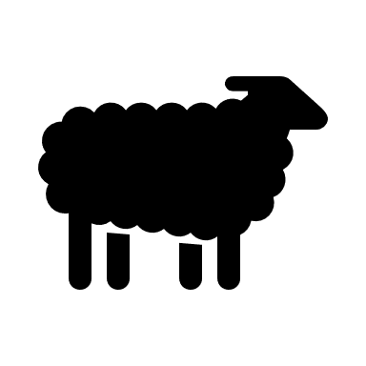


Class
A class is a type or blueprint of an entity
Its instance is called as object
An object of a class will represent a specific type
Animal
Name
Legs
Sound
Food
Sheep
4
Bleat
Grass
Dog
4
Bark
Meat
Duck
2
Quack
Seeds
Class
Objects/Instances

Slide 125
Classes In UML
Shown as a rectangle split into three sections
top contains the name
middle contains attributes
bottom contains operations (methods)
ClassName
Attribute
Attribute
ClassName
Operation
Operation

Slide 126
Example : Class
Car
Account
manufacturer
chasisno
fuel
speed
no
name
balance
type
SwitchOn
SwitchOff
Accelerate
Brake
GetBalance
Withdraw
Deposit
IssueCheck

Slide 127

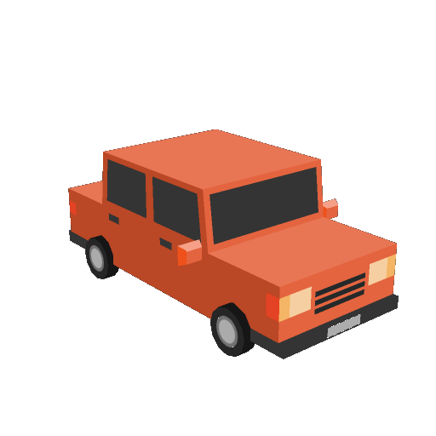
Objects in Reckless Driver
TrafficCar
HotdogCart
NewspaperBox
FireHydrant
Tree
PlayerCar
PostBox

Slide 129
Object Oriented Programming

Slide 130
Object Oriented Programming
The system is organized as a set of classes & objects
Classes & objects are associated in different ways
The implementation is done in an object oriented programming language
OO languages are build upon the elements of object model

Slide 131
Elements of Object Model
OO languages build upon these elements to support object oriented programming
Abstraction
Encapsulation
Hierarchy
Polymorphism
Some languages may not support all these elements
Javascript, VBA

Slide 132
Abstraction
Denotes essential characteristics of an object
distinguish it from other objects
relative to the perspective of the viewer
It is a simplified view or specification that emphasizes some details while suppressing/ignoring others
Unnecessary details are left out
they may not be relevant to the problem domain
A class/struct/interface is an abstraction

Slide 133

Example
SCHOOL
INNOCULATION
Name
RollNo
Class
Registration No.
Marks
GetGrade
CalculateTotalScore
Name
Age
Weight
Gender
Allergies
School
History
AddRecord
GetRecord

Slide 134
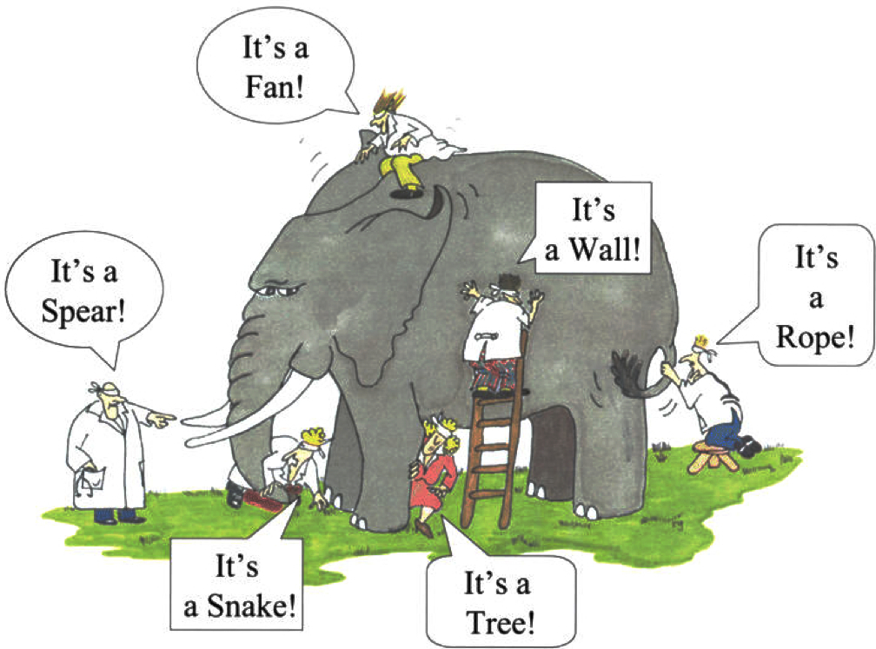
Abstraction
The abstraction is performed based on the domain
Performing correct abstraction for a given domain in necessary
Domain expertise is important for performing correct abstraction
Focus on entity abstraction
represents a useful model of domain entity
closely matches with the vocabulary of the problem domain
e.g Bank, Account, Transaction, etc
Notes:
Entity abstraction is implemented as a class/structure in OO languages

Slide 135

Example
Car
TrafficCar
manufacturer
chasisno
fuel
speed
damage
speed
damageCash
OnCollision
GetDamage
SwitchOn
SwitchOff
Accelerate
Brake

Slide 136
Object Responsibility
The abstraction provides the services or uses services of some other object
this forms the behaviour of the abstraction
provides an outside view
This view defines a contract that others depend on
This behaviour forms the responsibility of the abstraction
provided as operations, methods or member functions
collectively called protocol
protocol forms the static and dynamic view of the abstraction
includes static & dynamic properties of abstraction
Notes:
The inside view carries out the contract that the other depend on

Slide 137
Advantages
Resolves complexity
Makes it simpler to model a solution for a problem
Unnecessary details are left out
Focuses on the details relevant to the problem domain
Represents real-life objects in software as domain entities

Slide 138
Abstraction
The elements of abstraction provide a behaviour of the object through implementation
Upholds the contract of its behaviour
This implementation should be treated as a secret
kept hidden from clients
This is achieved through encapsulation

Slide 139
Encapsulation
Hides the implementation details of an object
Focuses on the implementation that gives rise to the behaviour
Achieved through information hiding
Structure and implementation of the methods is hidden
Client only knows about the contract
Shielded from implementation details at lower level of abstraction

Slide 140
Encapsulation
Abstractions work only when encapsulated
Every class will have two parts: an interface and an implementation
Interface captures the outside view and provides the behaviour
Clients will make assumptions based on the outside view
Implementation is encapsulated, so clients cannot make any assumptions on those details
In turn, the abstraction is required to be accountable for its behaviour

Slide 141
Advantages
Clients don’t (& shouldn’t) need to see the implementation details
Change in internal implementation doesn’t effect the clients
Encapsulation decouples clients from implementation details
Enforces state changes to object only through behaviour
Helps in building scalable & flexible systems

Slide 142





Example
Car
manufacturer
chasisno
fuel
speed
SwitchOn
SwitchOff
Accelerate
Brake

Slide 143
Car Class
Show the car class in various languages (DONE)
Show Car class in UML and show different symbols of access modifiers (DONE)
After that model the TrafficCar in all languages (or give that as assignment)
Add gear up/down for assignment for Car application

Slide 144
Hierarchy
Abstraction helps represent domain objects to resolve complexity
Encapsulation further hides the implementation details
The complexity can be reduced further by creating hierarchy of abstractions
hierarchy represents relationships between abstractions
Helps represent the problem domain and its objects
The important hierarchies in a complex system are
inheritance
composition

Slide 145
Inheritance
Also known as “is a” relation or generalization
Represents a relationship where one class is a kind of other
A class (base or super class) will share its structure and behaviour with another class(child class or subclass)
The base class contains important behaviour which must be exhibited by other classes
Any class can inherit the behaviour from the base class
may provide a specialized implementation of the behaviour
Inheritance implies generalization/specialization hierarchy

Slide 146
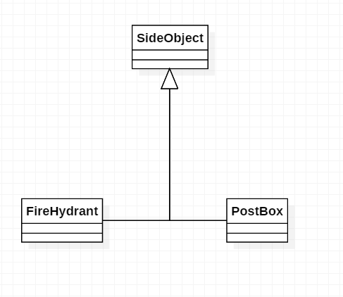
Examples
Car
ElectricCar
PetrolCar

Slide 147
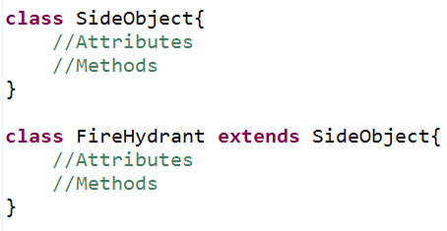
Java

Slide 148
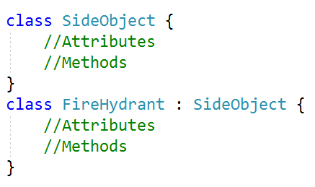
C#

Slide 149
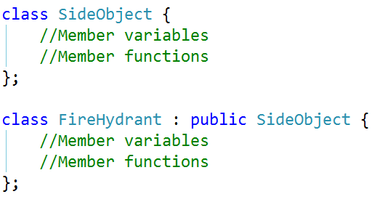
C++

Slide 150
Abstract Class
Some methods in the base class may not have an implementation
These methods exist to provide only the behaviour that the subclasses must implement
Such methods are abstract (or pure virtual in C++) and the class also becomes an abstract class
An abstract class cannot be instantiated
It can have non-abstract methods, fields, static members, etc
The subclass will become abstract if it does not override abstract methods from base

Slide 151
Example
Frame
+Create:void
+SetSystemIcon(icon:Icon):void
+SetTitle(title:sting):void
Window
+Create:void
+SetSystemIcon(icon:Icon):void

Slide 152
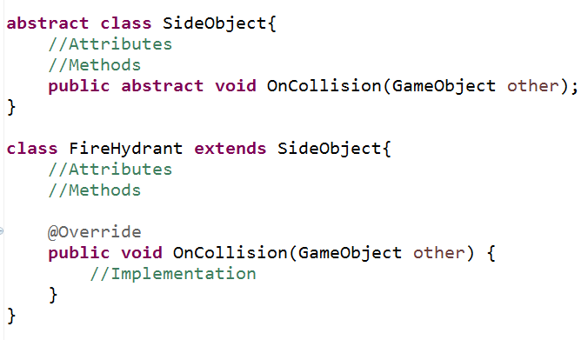
Java

Slide 153
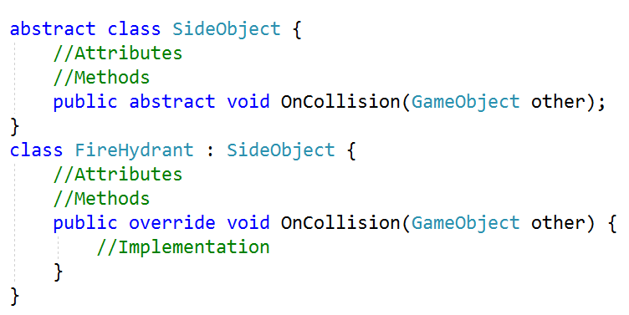
C#

Slide 154
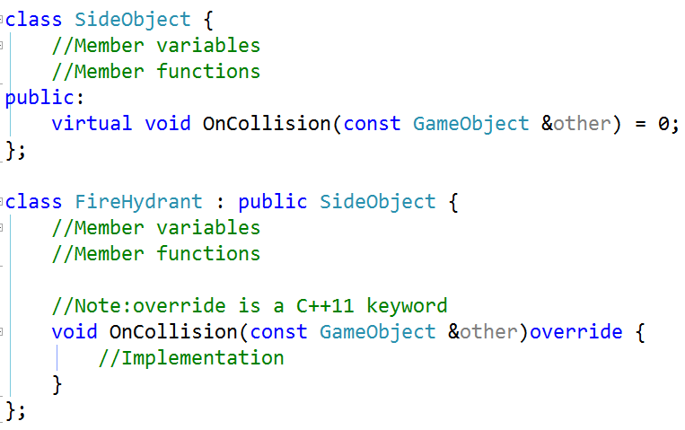
C++

Slide 155
Interface
Collection of operations that do not have any implementation
Similar to abstract class that has all methods as abstract (or pure virtual)
cannot be instantiated
all methods are implicitly public
The methods have to be implemented by the child classes
Interfaces are used as connections between applications or libraries or components

Slide 156
Interface
<<interface>>
ISerializable
+Serialize(out:ofstream):void
+Deserialize(in:ifstream):void
Employee
+Serialize(out:ofstream):void
+Deserialize(in:ifstream):void
Realization Arrow
ISerializable
Employee
+Serialize(out:ofstream):void
+Deserialize(in:ifstream):void

Slide 157
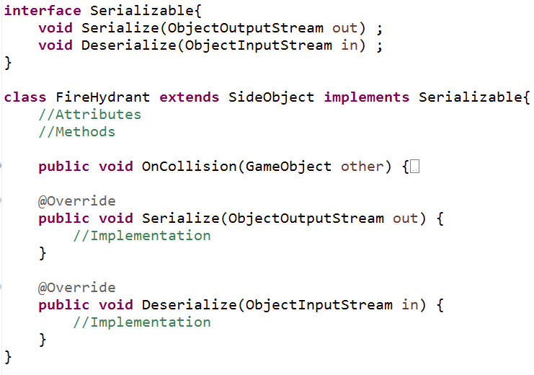
Java

Slide 158
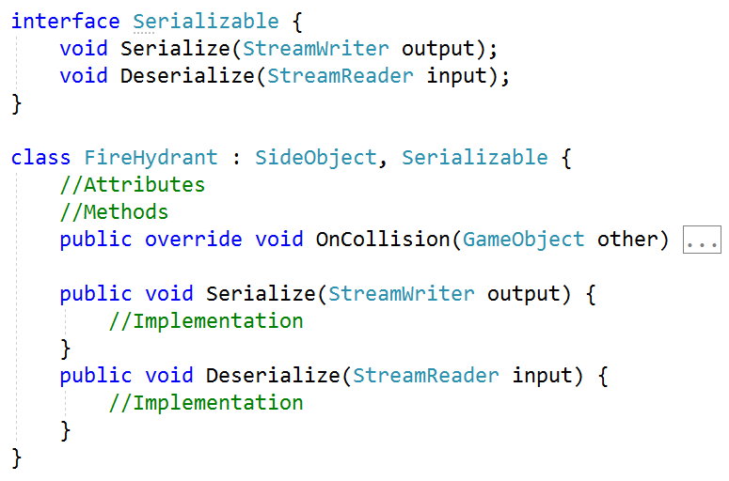
C#

Slide 159
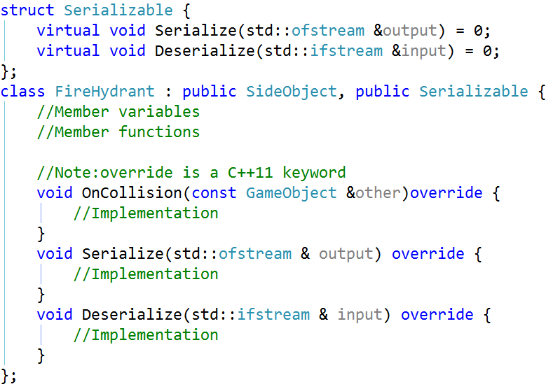
C++

Slide 160
Abstract Class Vs. Interface
Abstract Class
Interface
Can contain fields or methods
May provide default implementation of some behaviour
Subclasses extend the behaviour of the base
Subclasses cannot inherit from multiple abstract classes
Can have different access modifiers
Use to represent common behaviour and implementation when different subclasses are related
Contains only behaviour
Cannot contain any implementation
Subclasses implement the behaviour of the interface
Subclasses can implement multiple interfaces
All methods are public
Use to represent common behaviour that “must” be implemented by disparate classes

Slide 161
Containment
This is a relationship between objects
Signifies “has a” relationship
One object may contain another object to reuse its behaviour
Multiple forms of containment exist
Composition
Aggregation
Association
Dependency

Slide 162
Composition
This is a strong relationship & signifies a physical containment
One object is “part of” another object
The outer object is responsible for its lifetime
E.g. Button is part of Window
When the Window is closed, the button is also destroyed

Slide 163
Example
Window
Button
FireHydrant
Fountain

Slide 164
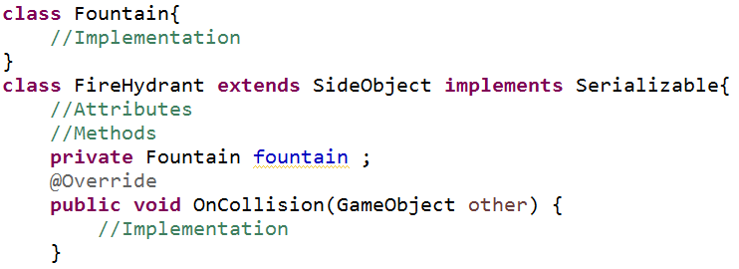
Java

Slide 165
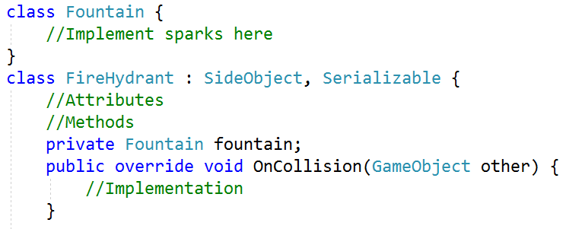
C#

Slide 166
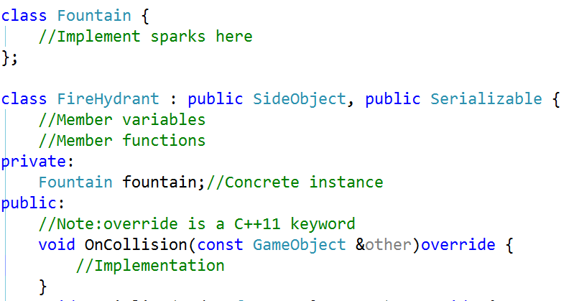
C++

Slide 167
Aggregation
Denotes a logical containment of an object
Weaker than composition
E.g. training has students
Training does not physically contain the students
The students are shared with other trainings
A training does not control the lifetime of its students; they exist independently

Slide 168
Example
Training
students
Training
Student
Car
Passenger

Slide 169
Association
This also implies reuse of objects
Represents a semantic connection between the classes
A class will contain a reference of another object and use it for some time
Often accompanied with phrases such as uses, controls, etc
E.g. Analyst analyses Requirements

Slide 170
Example
Analyst
analyses
Requirements
Driver
drives
Car

Slide 171
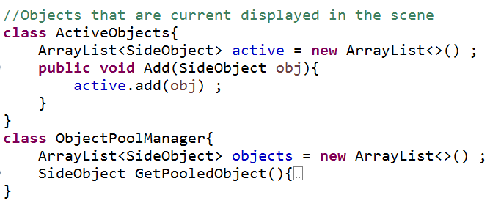
Java

Slide 172
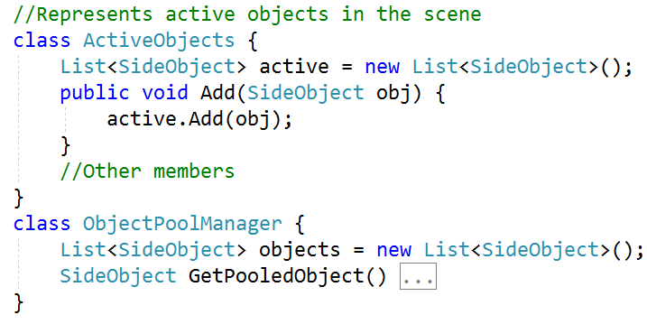
C#

Slide 173
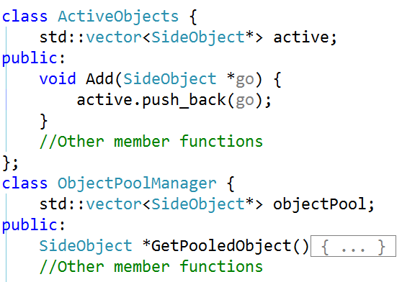
C++

Slide 174
Dependency
Weakest form of relationship
This relationship is formed when an object works with another object briefly
a class method accepts an object of another class
E.g. a Player rolls a Dice
Player
Dice
FireHydrant
damages
PlayerCar

Slide 175
Java

Slide 176
C#

Slide 177
C++

Slide 178
Relationship Types
Weaker Class Relationship
Strong class relationship
Dependency
Association
Aggregation
Composition
Inheritance
Dashed Arrow
Simple Line
Empty Diamond Arrow
Filled Diamond Arrow
Empty Arrow
When objects of one class work briefly with objects of another class
When objects of one class work with objects of another class for some prolonged amount of time
When one class owns but shares a reference to objects of another class
When one class owns & contains objects of another class
When one class is a type of another class

Slide 179
Polymorphism
Means different forms
These forms represent different implementations of the same behaviour in different objects
They are united via inheritance
The behaviour is invoked on the base/super object, but the action is performed on its child object
The child class overrides the implementation of the base

Slide 180
Polymorphism
OO languages support polymorphism in many ways
Compile time polymorphism or parametric polymorphism
methods are resolved at compile time (overloading, templates)
Dynamic polymorphism
methods are resolved at runtime (virtual mechanism)
Notes:
Compile time polymorphism can be achieved through function overloading or function templates in C++. In the first case, it is called as parametric polymorphism because the type of function to call is determined by examination of the parameters of the function call.
Following is an example of compile time polymorphism
#include <iostream>
using namespace std ;
class Rectangle
{
public:
void Draw()
{
cout << "Rectangle::Draw" << endl;
}
} ;
class Line
{
public:
void Draw()
{
cout << "Line::Draw" << endl;
}
} ;
template<typename Shape>
void DrawShape(Shape & shape)
{
for(int i = 0 ; i < 10 ; i++)
shape.Draw() ;
}
int main()
{
Rectangle r ;
Line l ;
DrawShape(r) ;
return 0 ;
}
Here the call to the Draw method is resolved at compile time, depending on the type of Shape.

Slide 181
Example
Shape
Function(Shape s){
s.Draw() ;
}
+Draw():void
Line
Circle
+Draw():void
+Draw():void

Slide 182
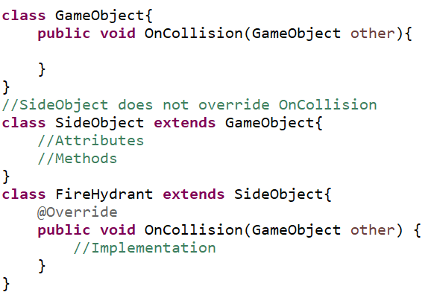
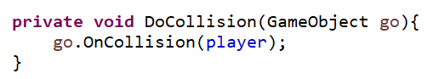
Java

Slide 183
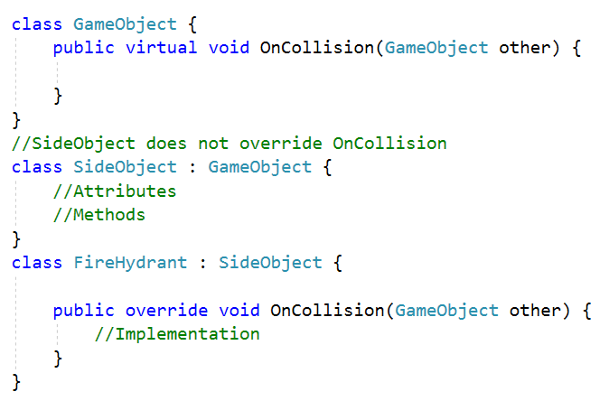
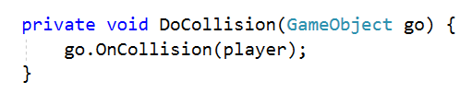
C#

Slide 184
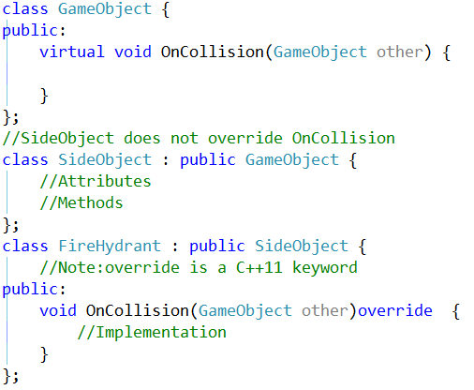
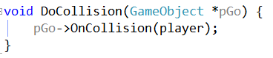
C++

Slide 185
Advantage
Promotes reuse
More classes can be added without requiring change to existing code
Certain implementations may not even require a recompilation of the binary
Works in tandem with containment and inheritance

Slide 186
New Game Implementation
Choose a vehicle
Create instance of the chosen vehicle
Create instance of player
Prepare the scenery
Create instance of Scene class
Assign player reference to Scene class
Run a loop until player health is 0
Generate NPCs
Player will drive the car (simulated)
Player will collide with other objects (simulated)

Slide 187
Scene Class
Responsible for representing a scene
Create environment objects (houses, trees, etc)
Generate NPCs (vehicles, sideobjects)
Simulate collision between the player and the NPCs

Slide 188
Interaction Diagrams
Interaction diagrams model the interactions between objects in some behaviour
Help visualize the interaction behaviour of the system in context of objects
Also describe the message flow in the system
Typically, used to look at behaviour of the system within a single use case
This interaction can be modelled with two diagrams
collaboration/communication
sequence

Slide 189
Communication Diagram
Communication diagram shows how objects associate with each other
The focus in on link, rather than the order
Communication diagram gives a big picture view of the interactions between different objects of the system
Also known as interaction/collaboration diagram
Easy to draw during discussion

Slide 190
Basic Elements
Contains three elements
participants
communication link
messages that can be passed along the link
Participants involved in the interaction
obj1:class1
obj2:class2
Link Supports interaction between obj1 & obj2

Slide 191
Participants
Represented by a rectangle
Name of the participant and its class are placed in the rectangle as <name>:<class>
Both name & class may be specified
However, either of them can be left out if the participant is anonymous
obj1:class1

Slide 192
Communication Link
Shown as a single line
Connects two participants
Allows messages to be passed between different participants
Without the link, participants cannot interact with each other
obj1:class1
obj2:class2

Slide 193
Messages
Depicted as a filled arrow from message sender to the message receiver
The signature is made up of name & list of parameters
We need to show the order in which the messages are invoked
shown as a number before each message
1. MessageA()
obj1:class1
obj2:class2
2. MessageB()

Slide 194
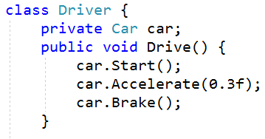
Example
1. Start()
Driver
drive()
2. Accelerate(amount)
+Drive():void
driver:Driver
bmw:Car
3. Brake()
Car
BrakeSystem
+Start():void
+Accelerate(amount:float):void
+Brake():void
+Engage():void

Slide 195
Nested Messages
A message that is invoked because of another message is called nested message
The number scheme for such nested message uses the base message number followed by new number e.g. 1.1 MessageX()
1. MessageA()
1.1 MessageX()
obj1:class1
obj2:class2
obj3:class3
2. MessageB()
2.1 MessageY()

Slide 196
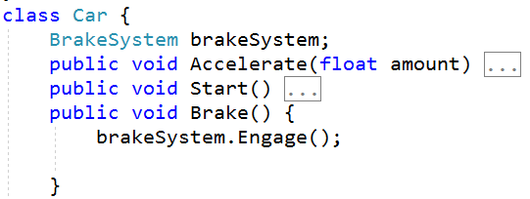
Example
1. Start()
drive()
2. Accelerate(amount)
3.1. Engage
driver:Driver
bmw:Car
brakeSystem:BrakeSystem
3. Brake()

Slide 197
Concurrent Messages
These are represented using number and letter notation e.g. 2.a. MessageX(), 2.b. MessageY(), etc
The other notation is to use an open arrowhead
1. MessageA()
1. MessageA()
obj1:class1
obj2:class2
obj1:class1
obj2:class2
2.a. MessageX()
2.b. MessageY()
2.c. MessageZ()
2.MessageX()
2.MessageY()
2.MessageZ()
Concurrent messages i.e. invoked at the same time

Slide 198
Example
1. Start()
2. Accelerate(amount)
3.1. SwitchOn()
driver:Driver
bmw:Car
brkLt:Light
3. Brake()
3.1. Engage()
brakeSystem:BrakeSystem

Slide 199
Conditional Messages
Some messages have to be sent based on a condition
The conditions for such messages are represented as guards
A guard is made up of a boolean statement, usually represented through pseudocode
1. [x > y] : MessageA()
obj1:class1
obj2:class2
2. [c = true] : MessageB()

Slide 200
Example
1. [fuelLevel > 0] : Start()
driver:Driver
bmw:Car
2. [gear != neutral] : Accelerate()

Slide 201
Looping Messages
A looping message is shown with an asterisk before a looping constraint
This constraint is represented just like a guard statement
May contain a condition with boolean statement or counter variable
1. *[i = 0..9] : MessageA()
1.1. *: MessageC()
obj1:class1
obj2:class2
obj3:class3
2. * [i < 9] : MessageB()
2.a. *||[i=1..5]: MessageX()

Slide 202
Example
1. *[trip ==true] : Run()
taxi:Car
fareMeter:Meter

Slide 203
Messages To Self
An object may call a method on itself
e.g. a method may call a private internal method
Represented through the link from participant to itself with a message
obj2:class2
1. MethodA()

Slide 204
Create Message
This message creates an instance of a class
It can be represented in multiple ways
Message name is Create with argument as the name of the class (signifies call to constructor)
Use the stereotype <<create>> on the message with any name
1. Create(class2)
obj1:class1
obj2:class2
<<create>>
1. make(class2)

Slide 205
Destroy Message
This message destroys an instance of a class
Use the stereotype <<destroy>> on the message
Can be used to show explicit destruction of an object e.g. in C++, we use the delete operator
obj1:class1
obj2:class2
<<destroy>>
1. delete(class2)

Slide 206
Sequence Diagram
Used to show interactions between objects in a sequential order
Often generated as an outcome of refinement of use cases
Useful to stakeholders to understand the system’s behaviour
May be used for designing new systems or depicting interactions in existing systems
Helps understand how the control/events flow between the objects

Slide 207
Participant
A participant is some part in the system that interacts with other participants
It is always placed at the top of the diagram
participants are arranged horizontally
Each participant has a corresponding lifeline that runs down the page
The name of the participant is put in the box in the format object:class
obj:class

Slide 208
Time
Ordering is important in a sequence diagram
The ordering is represented through time as lifelines
The lifelines run down from the top
Note that the lifeline does not represent duration
obj:class
Time

Slide 209
Message
An interaction allows the participants to communicate with each other
Communication happens through messages
Specified as an arrow towards the participant accepting the message
A message can flow from any direction
participant to other participant & back
participant to self
A message may optionally show the message signature

Slide 210
Activation/Execution Bar
Participants are shown as boxes with name inside (instance of a class)
Arrows represent messages
Activation bar indicates execution and is optional
Note that it only represents time, but not duration
obj1:class1
obj2:class2
synchronous message
result
message to self

Slide 211
Example
driver:Driver
bmw:Car
Accelerate()
Accelerate(amount:float)
Notes:
Example message signature Description
doSomething( ) The message’s name is doSomething, but no further information is known about it.
doSomething(number1 : Number, number2 : Number) The message’s name is doSomething, and it takes two arguments, number1 and number2, which are both of class Number.
doSomething( ) : ReturnClass The message’s name is doSomething; it takes no arguments and returns an object of class ReturnClass.
myVar = doSomething( ) : ReturnClass The message’s name is doSomething; it takes no arguments, and it returns an object of class ReturnClass that is assigned to the myVar attribute of the message caller.

Slide 212
Example
user
cart
addItem()
addItem(item1:Item)
UpdateItemCount
success
Notes:
Example message signature Description
doSomething( ) The message’s name is doSomething, but no further information is known about it.
doSomething(number1 : Number, number2 : Number) The message’s name is doSomething, and it takes two arguments, number1 and number2, which are both of class Number.
doSomething( ) : ReturnClass The message’s name is doSomething; it takes no arguments and returns an object of class ReturnClass.
myVar = doSomething( ) : ReturnClass The message’s name is doSomething; it takes no arguments, and it returns an object of class ReturnClass that is assigned to the myVar attribute of the message caller.

Slide 213
Message Types
Synchronous message
Asynchronous message
Return message (can be ignored)
<<create>>
obj:class
Participant creation message
<<destroy>>
Participant destruction message

Slide 214
Asynchronous Message
In some case, we want to execute a set of interactions at the same time
We may or may not wait for them to finish
This is required during asynchronous execution of some process
prevent the UI from getting blocked
execute multiple tasks at the same time for efficiency

Slide 215
Example
driver:Driver
bmw:Car
brkLt:Light
brakeSystem:BrakeSystem
Brake()
SwitchOn()
Engage()
Notes:
Example message signature Description
doSomething( ) The message’s name is doSomething, but no further information is known about it.
doSomething(number1 : Number, number2 : Number) The message’s name is doSomething, and it takes two arguments, number1 and number2, which are both of class Number.
doSomething( ) : ReturnClass The message’s name is doSomething; it takes no arguments and returns an object of class ReturnClass.
myVar = doSomething( ) : ReturnClass The message’s name is doSomething; it takes no arguments, and it returns an object of class ReturnClass that is assigned to the myVar attribute of the message caller.

Slide 216
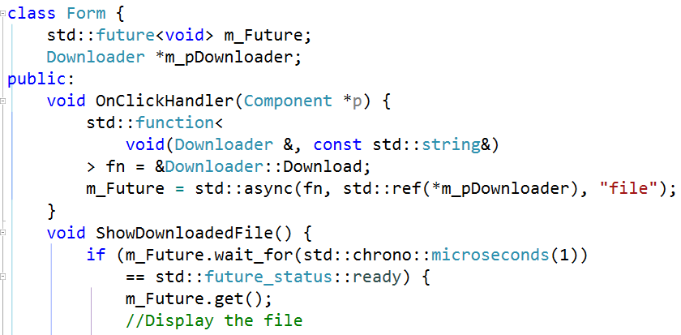
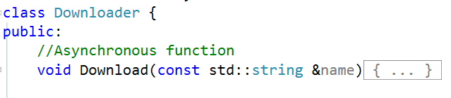
Example
form
m_pDldr
grid
Download()
SortColumn()
Connect()

Slide 217
Create & Destroy Message
Create message creates instance of a class
Shown as stereotype <<create>> over the message arrow
Destroy message destroys the instance
It is shown as stereotype <<destroy>>
Can be used to show explicit destruction of objects e.g. in C++, we use delete to destroy a heap-based object

Slide 218
Create & Destroy
m_pDldr
Connect()
<<create>>
socket
ReadData()
data
<<destroy>>

Slide 219
Fragments
Sequence diagrams also depict loops, conditional execution, alternative execution, etc
can quickly grow and become unmanageable
These interactions can be shown through fragments
A fragment is a box that encloses the portion of the interaction
can contain any number of interactions
can contain other fragments

Slide 220
Fragment Types
ref
used to represent an interaction that is defined elsewhere in the model
loop
loops through interactions within the fragment any number of times (condition is shown as a guard statement)
break
used to break out of a loop fragment (similar to break statement)
opt
the interaction in this fragment is executed only if the guard condition is true

Slide 221
Example : loop Fragment
taxi:Car
fareMeter:Meter
loop
[trip=true]
Run()
fare

Slide 222
Example : opt Fragment
driver:Driver
bmw:Car
opt
[fuel > 0]
Start()
opt
[gear != neutral]
Accelerate()

Slide 223
Example : opt Fragment
<<actor>>
customer
atm
account
Transact()
Withdraw()
opt
[amount > balance]
DisplayMessage()

Slide 224
Example
GameManager
:Player
:SideObject
newGame
<<create>>
createPlayer
loop
[isAlive=true]
opt
[collision=true]
collide
showBehavior
applyDamage
calculateCash
accumulateCash

Slide 225
Example
GameManager
playerCar:Player
scene:Scene
newGame
<<create>>
createPlayer
<<create>>
createScene
sedan:Traffic
loop
GenerateNPCs
<<create>>
CreateTraffic
[isAlive=true]
opt
[collision=true]
OnCollision(player)
applyDamage
showBehavior
calculateCash
accumulateCash

Slide 226
Sequence Vs Communication
Sequence Diagram
Shows the sequence or ordering of messages
Large set of detailed notations
Consumes horizontal space
Difficult to use during brainstorming
Message order is depicted clearly
Communication Diagram
Focus on the links and the organization of objects
Fewer notation options
Requires less space
Easy & flexible to draw during brainstorming
Difficult to see the sequence of messages

Slide 227
State
An object’s state is the condition in which it exists
through the values of its attributes
It can be a passive quality that is used to decide the what the object will do when methods are invoked
It can also be an operation that the object executes
Notes:
A situation for which some invariant condition holds

Slide 228
State Machine Diagram
An object’s behaviour may change based on it state
Its helpful to model such states and the events causing changes
State machine diagram can be used for modelling this behaviour
Part of the logical view of the system
Useful in various fields such as mathematics, AI, games, etc
Notes:
A Finite State Machine, or FSM, is a computation model that can be used to simulate sequential logic, or, in other words, to represent and control execution flow. Finite State Machines can be used to model problems in many fields, including mathematics, artificial intelligence, games or linguistics.
A Finite State Machine is a model of computation based on a hypothetical machine made of one or more states. Only one single state of this machine can be active at the same time. It means the machine has to transition from one state to another in to perform different actions.

Slide 229
State
A state is drawn as a rounded rectangle
Name starts with a capital letter, at the top
May have several compartments to represent other properties of the state
State diagrams usually have initial pseudostate and a final state
represent start and end points of the state machine

Slide 230
State
On
Initial pseudostate
State
Working
do/write code
State with behavior
Final state
Notes:
Initial pseudostate is not a state , instead it represents the start of the diagram.
Final state shows the termination of the state machine

Slide 231
Transitions
Represent the change from one state to the other
Transitions are drawn as arrows connecting states
A trigger causes a state change and is optionally written along the transition arrow
State A
Trigger
StateB
Initial pseudostate
Final state
Transition

Slide 232
Transition Description
Describes the cause of state change
trigger[guard]/behavior
Each element is optional
trigger: event that may cause the transition
[guard]: Boolean condition that allows/disallows the transition
behavior: activity that executes while the transition is taking place

Slide 233
Transitions & Triggers
The event will be triggered if
the action is performed
the guard condition evaluates to true
the internal behaviour of the state completes

Slide 234
Example
Playing
EndGame
Stopped
Alive
Collide[health == 0]/ShowMenu
Dead
Transacting
do/dispense cash
Waiting

Slide 235
Example
Patrolling
player seen/unsheathe sword
Attacking
player dies
take damage [health == 0]/fall down
player lost
Dying
player seen
player lost [time > 10 seconds]/sheathe sword
Searching

Slide 236
Internal State Behaviour
A state can list internal actions or state (do) activities that are performed in that state
These are represented through following labels
entry : behaviour performed upon entry into the state
do : ongoing behaviour that can be interrupted
exit : behaviour performed upon exit from the state (regardless of how the do activity finished)
entry & exit behaviours cannot be interrupted

Slide 237
Examples
Attacking
Booking
entry/draw gun
do/shoot
exit/holster gun
entry/login
do/enter details
exit/request

Slide 238
Self Transition
A self transition is a transition that starts & ends in the same state
It is shown with an arrow starting & pointing to the same rectangle
Self transition indicates the behaviour whose execution leads to the same state e.g. health-kit pickup
A self transition will cause the state to go through enter & exit behaviours again

Slide 239
Self Transition
deposit
FundsAvailable
[next file]/goto next
Playing
entry/open file
do/read
exit/close file
pick health
Healthy

Slide 240
Internal Transition
Internal transition is similar to a self transition, except the enter & exit behaviours do not execute
reload
verify details
Attacking
Booking
entry/draw gun
do/shoot
exit/holster gun
entry/login
do/enter details
exit/request

Slide 241
Choice Pseudostate
Used when a Boolean condition determines which transition is to be followed
Has one incoming transition and multiple outgoing transitions
The outgoing transitions have guards on them
The transition taken depends on the guard
Only one transition is evaluated; other are disabled
condition 1
condition 2

Slide 242
Example
[next file]/goto next
Playing
do/read file
[playlist finished]
Stopped

Slide 243
Concurrent States
Concurrent states execute concurrently
Concurrent states are represented by fork and join pseudostates
Fork breaks the incoming transition into concurrent transitions
Join merges concurrent incoming transitions into a single transition

Slide 244
Example
Steering
do/turn
Accelerating
do/open throttle
reach destination

Slide 245
Composite State
A composite state is made up of regions
Each region in the composite state contains a state machine
The regions are separated by a dotted line
When a composite state becomes active, all regions become active and start execution
Each region can operate independently & concurrently
A composite state is complete when every region’s state machine has finished execution

Slide 246
Composite State
Driving
Steering
do/turn
Regions
Accelerating
do/press pedal
Substate

Slide 247
Design Issues
Scene is tightly coupled with classes of powerups, vehicles & side objects
Addition of a new types requires modification of the scene class
As the number of objects grow, the complexity will increase
incomprehensible
difficult to maintain
less extensible
fragile
To avoid such problems, we should refactor our design

Slide 248
Refactoring
Technique to restructure existing code in such a way that it does not affect the external behaviour
The code is restructured through small transformations that preserve its behaviour
Each small transformation is called refactoring
The system is kept fully working after each refactoring, thereby reducing chances of breaking the entire system
Refactoring does not add new features
It should be a continuous process during development of software

Slide 249
Advantages
Reduces complexity of the code
debugging becomes easier
Helps lower the cost of maintenance
fewer bugs
New features can be added to existing code
makes it extensible
Lifespan of the system increases

Slide 250
Package Diagram
Packages/namespaces are used to organize classes in a large application
This reduces the complexity of understanding the architecture of the application
UML provides packages to model a group of classes
The packages are placed in a package diagram along with their dependencies
They are part of the development view

Slide 251
Package
chrono
network
chrono
math
io
math

Slide 252
Package Contents
A package organizes UML elements
These elements can be drawn inside the package
System
security
std
Console
Identity
list
Array
KeyStore
queue
C# Namespace
Java Package
C++ Namespace

Slide 253
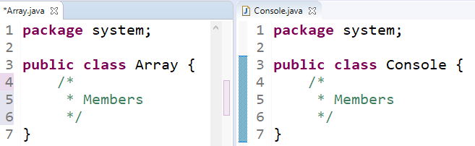
Java

Slide 254
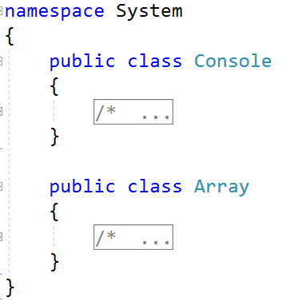
C#

Slide 255
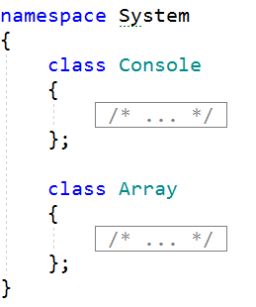
C++

Slide 256
Nested Packages
Packages can be nested
This allows us to model the deep nesting of packages in large applications
java
System
std
io
lang
IO
Threading
chrono
filesystem

Slide 257
Nested Packages
System
System::Runtime::Remoting
Runtime
Channels
Remoting
Channels

Slide 258
Nested Packages
System
IO
Threading

Slide 259
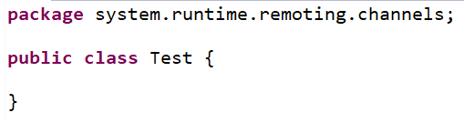
Java

Slide 260
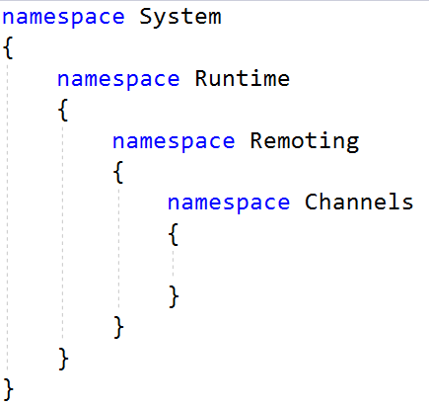
C#

Slide 261
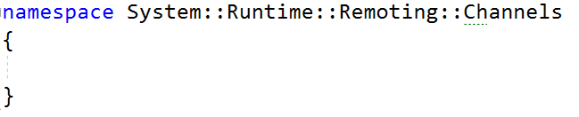
C++

Slide 262
Element Visibility
The elements inside the package can have two types of visibility – private & public
Elements with public visibility can be used outside the package
Elements with private visibility can be used only by elements of the same package
Public visibility uses the + sign & private visibility uses – sign

Slide 263
Example
Drawing
+ Graphics
- Software
- Hardware

Slide 264
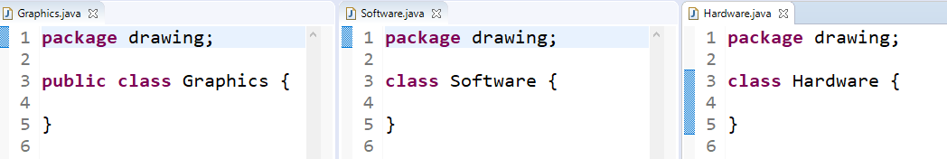
Java

Slide 265
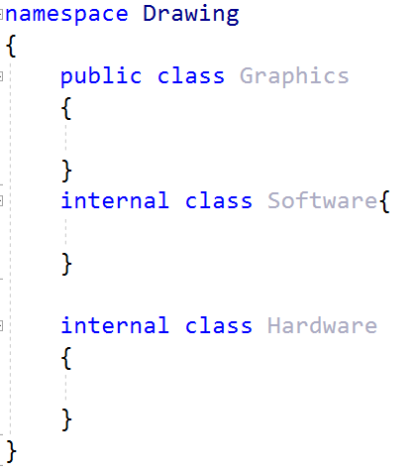
C#

Slide 266
C++
Doesn’t not support access modifiers at namespace or executable level

Slide 267
Importing Packages
To access an element in another package, you have to use full scoped names
Alternatively, a package can be imported that causes all the public elements to be available without using full scoped names
The imported package is called target package
The import creates a dependency & is shown with a dashed arrow
The arrow points to the target package & uses <<import>> stereotype
A package can import a specific element instead of the whole package
Note that the element should be public

Slide 268
Examples
payment
<<import>>
order
<<import>>
gui
+form
+view

Slide 269
Imports
The import relation itself has visibility
An import can be public import or private import
In public import, elements have public visibility inside the importing package
To avoid exposing the imported package elements, you can use private import by specifying <<access>> stereotype

Slide 270
Example
C
<<import>>
A
B
<<import>>
Elements of package B & C are available to A
Elements of package C & D are available to B
<<access>>
D

Slide 271
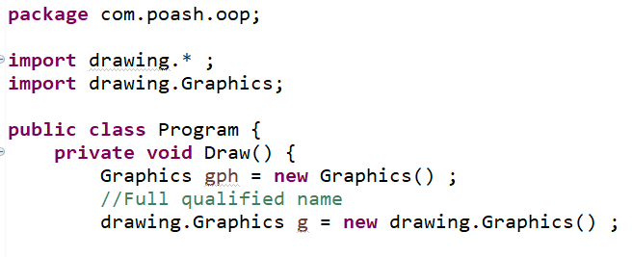
Java

Slide 272
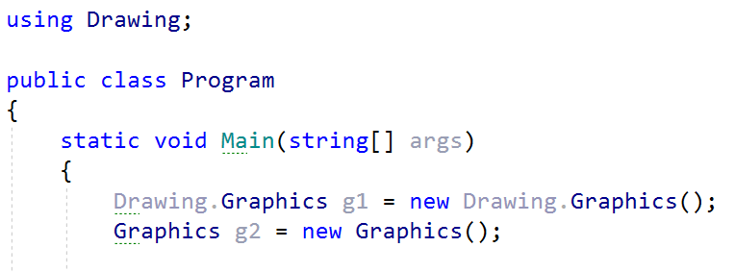
C#

Slide 273
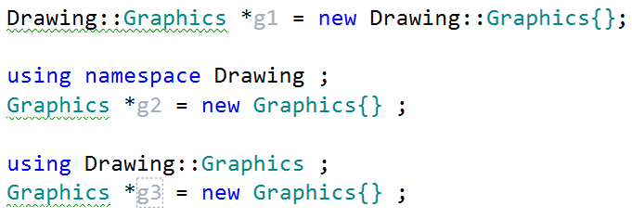
C++

Slide 274
When to use
To show high-level view of the system
The view could be requirements or design
Organize the complexity by dividing the system into modules
Keep track of dependencies
Understand how major parts of the system relate to each other
Notes:
A large complex project can contain thousands of classes. If these classes are not organized, it will become difficult to work with it.
Packages lend a structure to your classes or other UML elements by grouping them

Slide 275
Components
Encapsulated, reusable, autonomous & replaceable part of software
Building blocks that can be combined together to form larger components
Can be a class or a large subsystem
Components perform key functionality and are used frequently throughout the software e.g. logger, parsers, payment processors, etc

Slide 276
Components
Perform same operations as a class, but have bigger responsibilities
They can generalize or compose other classes or components, implement interfaces, etc
Components are important part of a design, therefore, must be loosely coupled
changing one component should not affect the other parts of your software
UML provides notations for representing components through component diagram

Slide 277
Component Diagram
A component is represented as a rectangle with <<component>> stereotype and optional tabbed rectangle at a corner
<<component>>
name
<<component>>
box2D
<<component>>
XMLParser
Notes:
A component is a reusable, autonomous, encapsulated and replaceable part of the software
The are the building blocks of the application
could be a class or a module
loosely coupled with other components
Provides a high level architectural view of the system

Slide 278
Component Interface
Components are loosely coupled
The loose coupling is achieved through interfaces
The components should communicate only through interfaces in order to be replaceable or swappable with other components
The components interact with each other through provided or required interfaces
provided : interface that the component implements
required : interface that the component needs to function

Slide 279
Provided Interface
A provided interface of a component is the interface that the component realizes i.e. implements
Other components and classes will interact with the component through its provided interface
Provided interface describes the service that the component provides
UML provides ball notation for provided interfaces
<<component>>
name
interface
Provided interface

Slide 280
Required Interface
A required interface is the interface that the component needs to function
Another component or class should realize the interface for this component to work
Simply declares the services a component will need
Provided as socket joint notation
<<component>>
name
interface
Required interface
Notes:
Also called as assembly connector

Slide 281
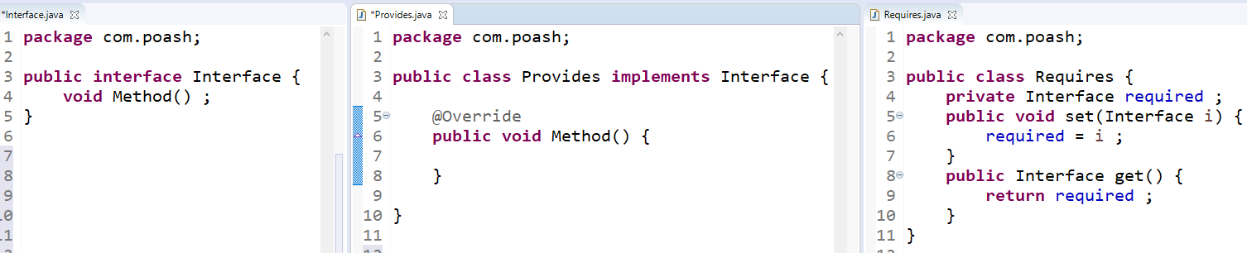
Java
Interface
Interface
Provided interface
Required interface

Slide 282

C#
Provided interface
Interface
Interface
Required interface

Slide 283

C++
Provided interface
Interface
Interface
Required interface

Slide 284
Interface Notation
There are several ways to show provided and required interfaces
Assembly connector (or ball & socket)
Ball & socket with dependency arrow
Dependency arrow
Stereotype notation
Listing component interfaces
Out of these, only stereotype notation allows you to show the methods inside the interfaces

Slide 285
Assembly Notation
Serializable
<<component>>
AppConfig
<<component>>
XMLSerializer
OnFolderChanged
<<component>>
Client
<<component>>
FileSystemWatcher
Notes:
Cannot show operations in the interfaces with this approach

Slide 286
Dependency Arrow
<<component>>
AppConfig
<<component>>
XMLSerializer
<<component>>
Client
<<component>>
FileSystemWatcher
Notes:
Cannot show operations in the interfaces with this approach

Slide 287
Ball & Socket with Dependency Arrow
IDbCommand
<<component>>
App
<<component>>
DatabaseLibrary
IDbConnection
IDataReader
Notes:
Cannot show operations in the interfaces with this approach

Slide 288
Stereotype Notation
<<interface>>
IDbConnection
<<interface>>
IDbCommand
+Open()
+Close()
+CreateCommand()
+CreateCommand()
+ExecuteReader()
Realization arrow
<<interface>>
IDataReader
<<component>>
DatabaseLibrary
+Read()
+NextResult()
Dependency arrow
Notes:
Helps show the operations

Slide 289
Component Interfaces
<<component>>
DatabaseLibrary
<<provided interfaces>>
IDbConnection
IDbCommand
<<required interfaces>>
IDataReader
<<artifacts>>
Database File
Notes:
Only shows the interfaces, but not the operations.
Artifacts show physical files that manifest the component. These will be discussed in deployment diagram.

Slide 290
Component Classes
Components are often made up of different classes to implement functionality
Such classes are said to realize the component
they help the component do its job
In UML, such classes can be shown in various ways
Inside the component
Realization arrow
List

Slide 291
Example
<<component>>
DatabaseLibrary
IDbCommand
Connection
Command
Transaction
IDataReader

Slide 292
Example
<<component>>
DatabaseLibrary
Connection
Command
Transaction

Slide 293
Example
<<component>>
DatabaseLibrary
<<provided interfaces>>
IDbConnection
IDbCommand
<<required interfaces>>
IDataReader
<<realizations>>
Command
Connection
Notes:
The first two can show relationship between realizing classes, this notation cannot

Slide 294
Port
Defines a point of interaction between a class and the outside world
Represents a distinct way through which a class or component is used by clients (other classes or components)
Port is drawn as a small rectangle on the boundary of the component
A name usually accompanies a port
A port can group multiple interfaces together that indicates the services available at that port
it can group both realized & required interfaces

Slide 295
Example
<<component>>
DatabaseLibrary
IDbCommand
DataSource
Logger
IDbConnection
IDataReader

Slide 296
Delegation Connectors
Ports let us map the interface to the classifier inside the component
This is indicated through delegation connector
A delegation connector is represented as a line with arrow
Depending on the port, the arrow may point away or towards it
Port represents an opening into a component through which communications pass
Delegation connector points to the direction of communication
These can also point directly to the internal part

Slide 297
Example
<<component>>
DatabaseLibrary
IDbCommand
DataSource
Connection
Transaction
Logger
IDbConnection
Delegation Connector

Slide 298
When to use
Plan high-level architecture of the system
Represent structure & organization of various components
Manage complexity & dependency among the parts
Understand connection between various components

Slide 299
Deployment Diagram
Represents the physical view in Kruchten’s 4+1 model
Concerned with the physical elements of the system
These elements are executable files and the hardware they run on
Describes the elements, where they’re located on the hardware and how they communicate with each other
Notes:
Unlike other diagrams that represent the logical view, a deployment diagram is concerned with the physical elements of the system

Slide 300
Node
The core part in a deployment diagram is a node
It shows the computer hardware and is shown in a 3D box with <<device>> stereotype and a name
The name can be general or a specific name i.e. PC is a general name, but Windows 10 x64 is a specific name
<<device>>
Name
<<device>>
PC
<<device>>
Windows 10 x64

Slide 301
Nodes
Nodes don’t need to represent a hardware
Some type of software provide an execution environment in which other software components can be executed
So, a node can be a hardware or software resource that can host software or related files
A software node can be an application context
generally not part of the software that is developed
provided by a third-party that provides services to our software
Examples of such execution environments are OS, Web server, Docker, App server, etc

Slide 302
Examples
<<executionEnvironment>>
docker
<<device>>
Linux Server
<<executionEnvironment>>
JVM
<<executionEnvironment>>
docker
<<executionEnvironment>>
VirtualBox
Notes:
Execution environments do not exist on their own, they run on hardware. e.g. an OS needs hardware to run on. So, you can show this by nesting the exeenviron node inside a device node to indicate it runs on that hardware

Slide 303
Node Communication
A node may have to communicate with other nodes to fulfil its tasks
This is shown through communication paths; a solid line that connects two nodes
The type of communication is shown through a stereotype
<<device>>
WindowsServer
<<device>>
PC
<<executionEnvironment>>
SurrogateProcess
<<RPC>>

Slide 304
Artifacts
An artifact is a physical file that is generated out of software development process
An artifact can be of the following type
Executable, such as .exe or .jar file
Libraries, such as .lib, .dll
Source files, such as .cpp, .java, .cs
Configuration files used by the software at runtime, such as .xml or .ini

Slide 305
Artifacts
UML provides multiple notations for represents artifacts
Artifacts are represented in a rectangle
with the <<artifact>> stereotype
with a document icon in top right corner
with a dependency arrow towards the node
If there are too many artifacts, you can list them directly inside a node
You can also show dependency between artifacts through a dependency arrow

Slide 306
Example
<<artifact>>
name
<<artifact>>
renderer.dll
<<artifact>>
utils.jar
<<artifact>>
props.xml

Slide 307
Example
<<device>>
PC
<<device>>
Android
<<artifact>>
rd.apk
<<deploy>>
<<artifact>>
renderer.dll
<<device>>
Windows 10
game.exe
Launcher.exe
opengl32.dll
steam.dll
controller.dll
<<device>>
Android
<<artifact>>
rd.apk

Slide 308
Artifacts
Software can be modularized through namespaces/packages or components
These are ultimately compiled into one or more files or artifacts
If an artifact is a physical representation of a component, then the artifact manifests that component
Note that artifact can manifest a class, package or a component
This relationship is shown through a dependency arrow with <<manifest>> stereotype
Notes:
Might clutter the diagram

Slide 309
Example
FileSystemWatcher
<<artifact>>
watcher.dll
<<manifest>>
OnFileChanged
Register
Unregister
<<artifact>>
sqlserver.dll
<<manifest>>
<<component>>
DatabaseLibrary
gui
<<artifact>>
winui.dll
<<manifest>>

Slide 310
Advantages
Useful in all stages of the design process
Especially, in the earlier stages, you can get an overview of the architecture of the system without dealing with details
A rough sketch can be created that can be refined in the later stages of software development
The refinement can help express the current view of the physical system with other stakeholders

Slide 311
When to use
Create rough sketch of the physical layout of the system
Discover issues involved in deployment process
Identify & explore dependencies between your software & its environment
Visualize the physical topology of the system’s deployment

